Slide 1

Front End Engineering –I Project Eventopia-An Innovative Event Booking Platform
Team Details:
Aalishna Taneja
Archi Dadhwal
Arshiya Saini
Arushi Luthra
Faculty Coordinator: Ms. Tapalagna Chakraboty

Slide 2

Table of Contents
.
Introduction
Problem Statement
Technical Details
Key features
Project Highlights
Bonus Feature
Conclusion
References/Links used

Slide 3
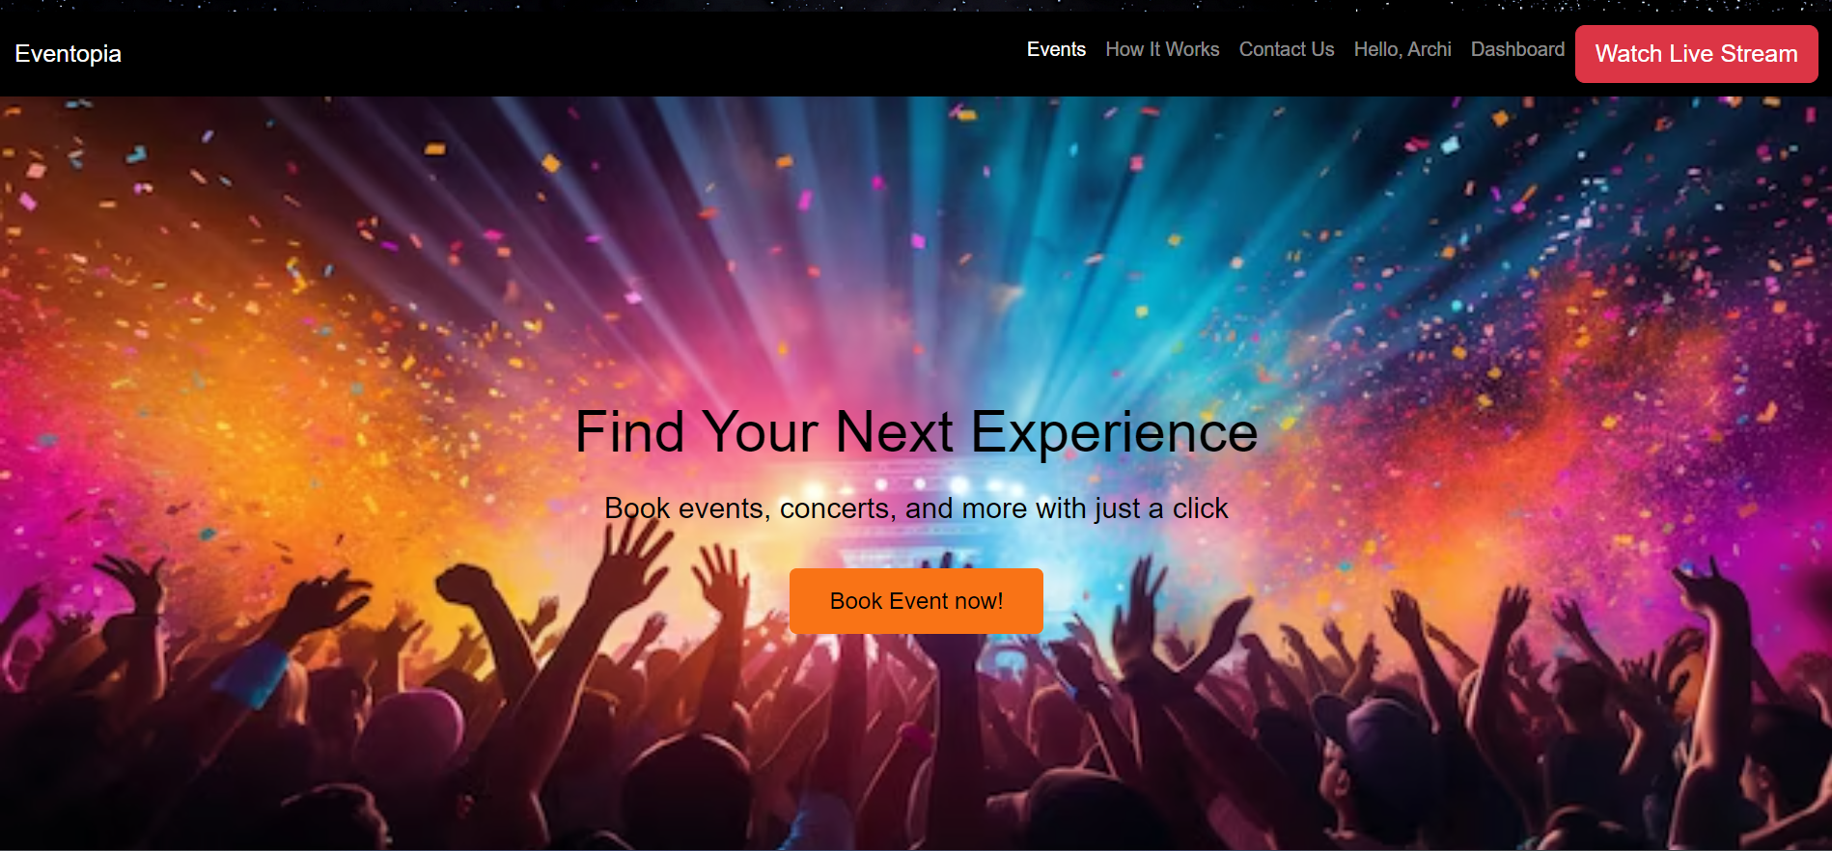
Introduction
Eventopia
It is designed to be a comprehensive online platform that streamlines the process of event booking and ticket management. The primary purpose is to provide a user-friendly interface for organizers and attendees to connect seamlessly, enabling efficient event planning, promotion, and ticket sales. The platform aims to cater to a wide range of events, from concerts and conferences to workshops and social gatherings, making it a versatile solution for various event types.

Slide 4
Problem Statement
Complex Event Management
Inefficient Ticketing Systems
Limited Event Visibility
Disjointed User Experience
Limited Customization Options

Slide 5
BACKGROUND RESEARCH
Background and Research:
Event Industry Growth:
The global events industry is expanding rapidly, with both virtual and in-person events gaining popularity. However, this growth has also led to increased competition among event organizers, necessitating efficient tools to manage and promote events effectively.
Market Analysis:
Research shows that users increasingly prefer all-in-one platforms that offer seamless event management and ticketing solutions.
User Pain Points:
Feedback from event attendees highlights the frustration with current ticketing systems, including long checkout processes, hidden fees, and difficulties in finding relevant events. Similarly, organizers express the need for more intuitive and comprehensive event management tools.

Slide 6
Technical Details
HTML
CSS
Javascript
Bootstrap

Slide 7


Key Features
Features
Event Type Selection
Venue Booking
Catering & Service Options
Ticket Management
Live Streaming Integration

Slide 8


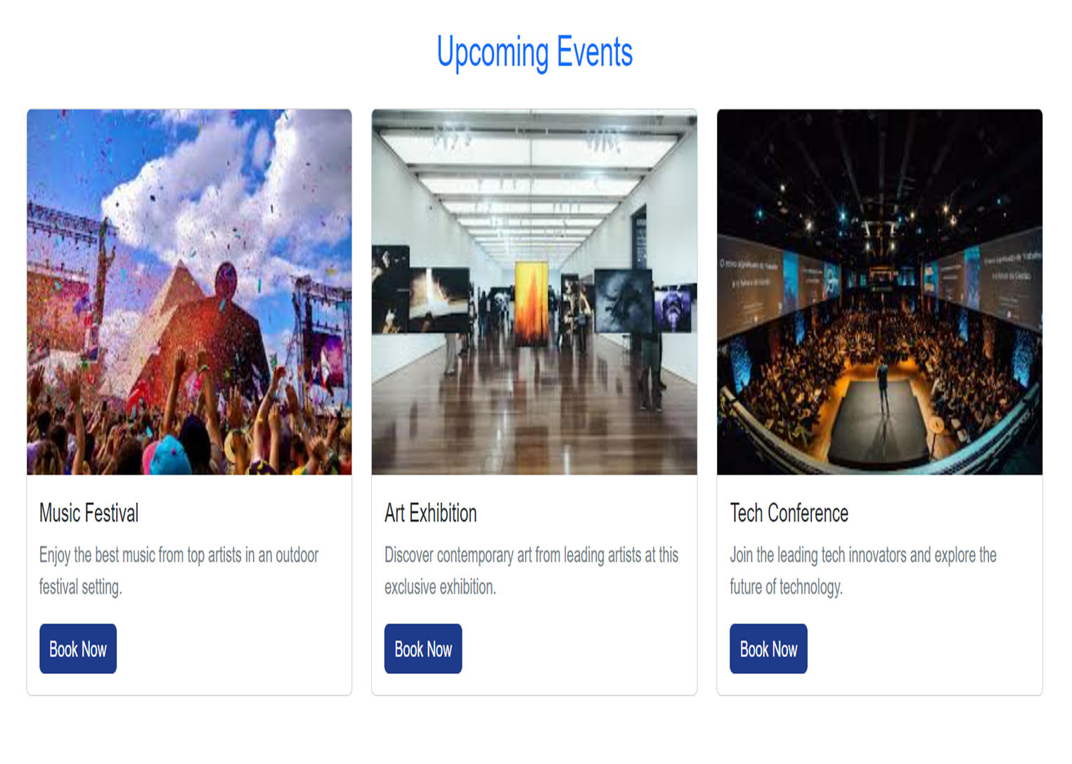
Project Highlights

Slide 9
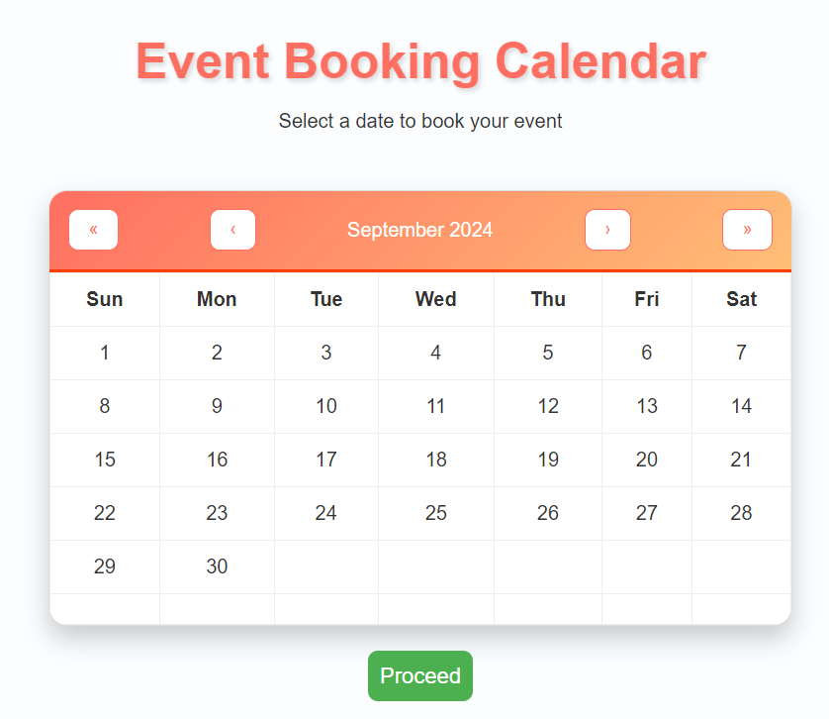
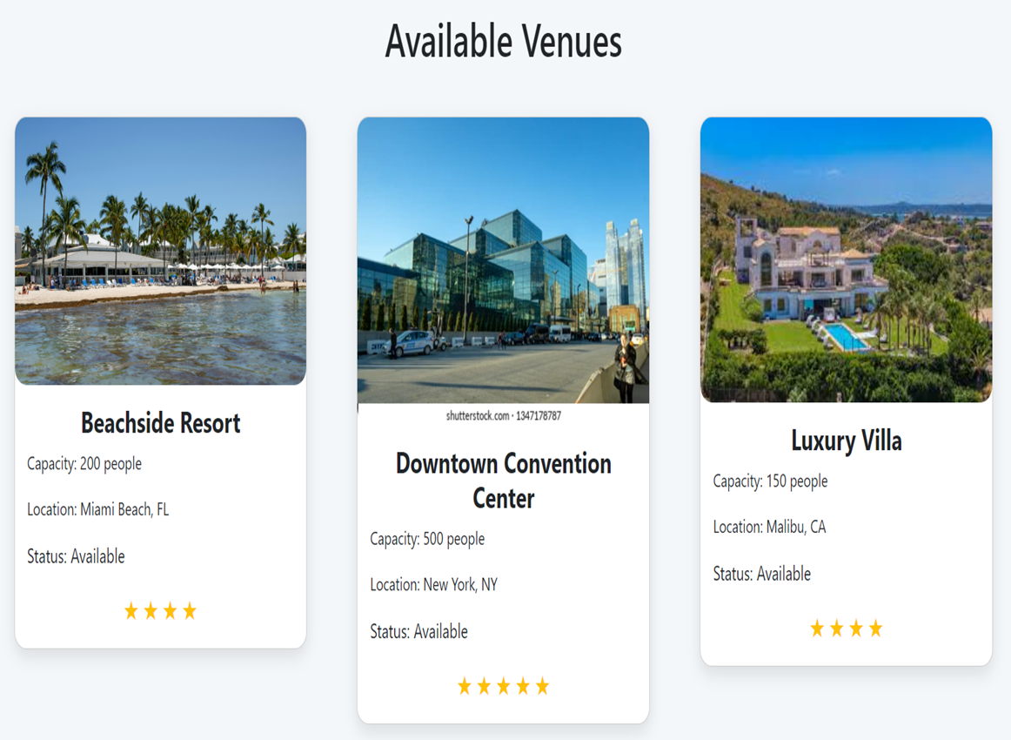
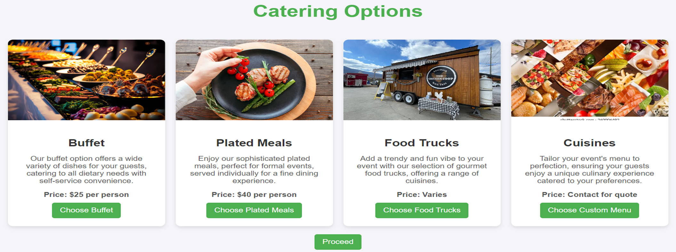

Slide 10
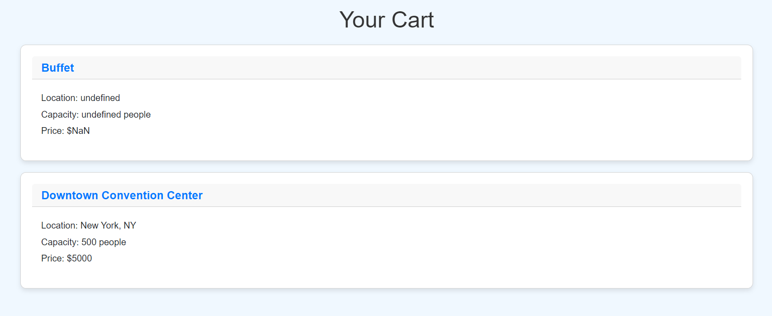
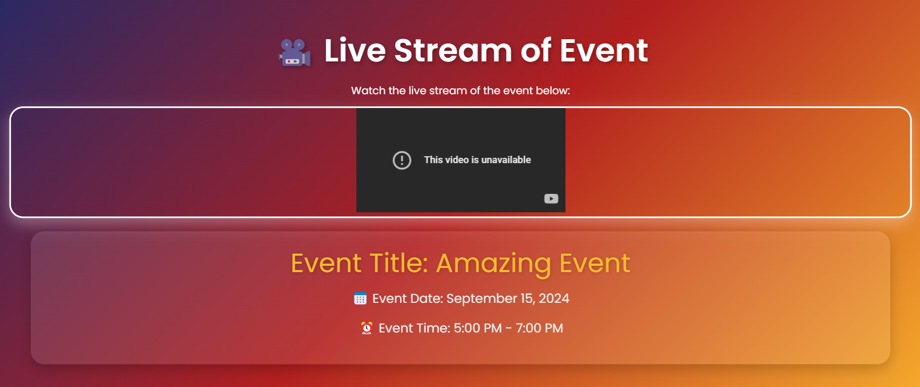
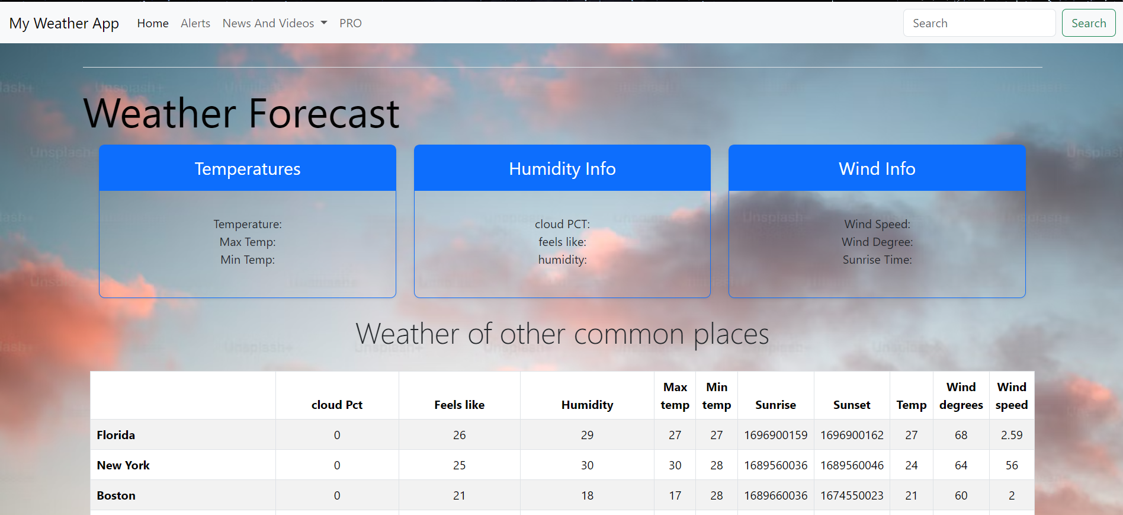

Slide 11
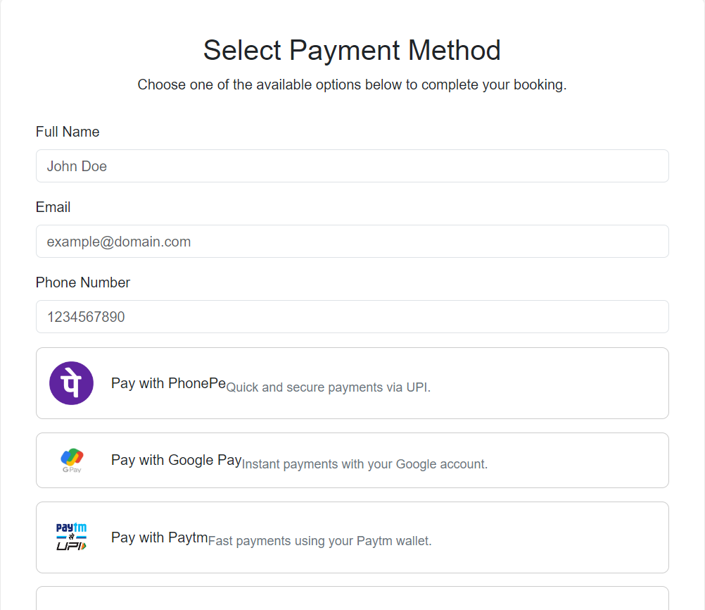
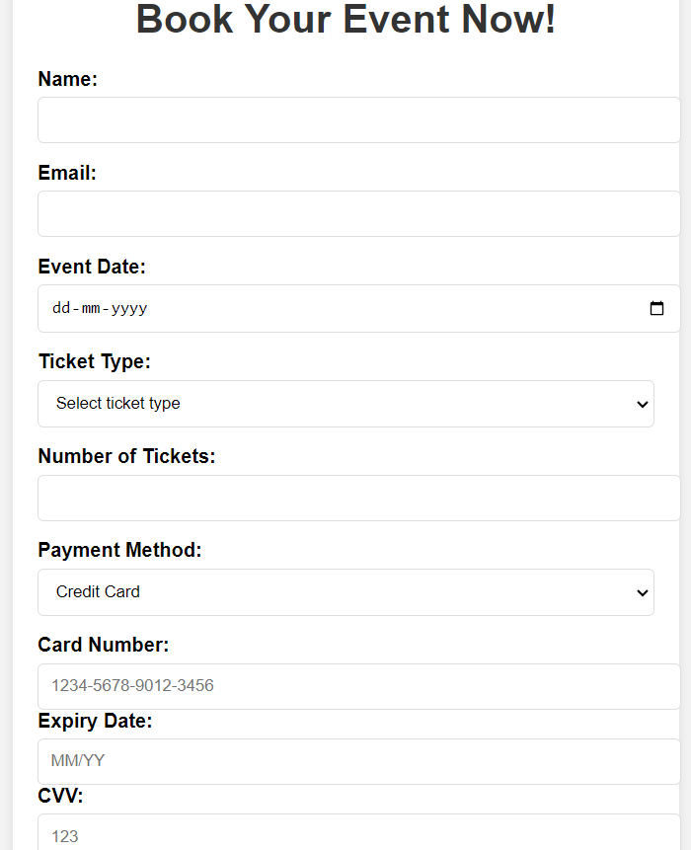

Slide 12
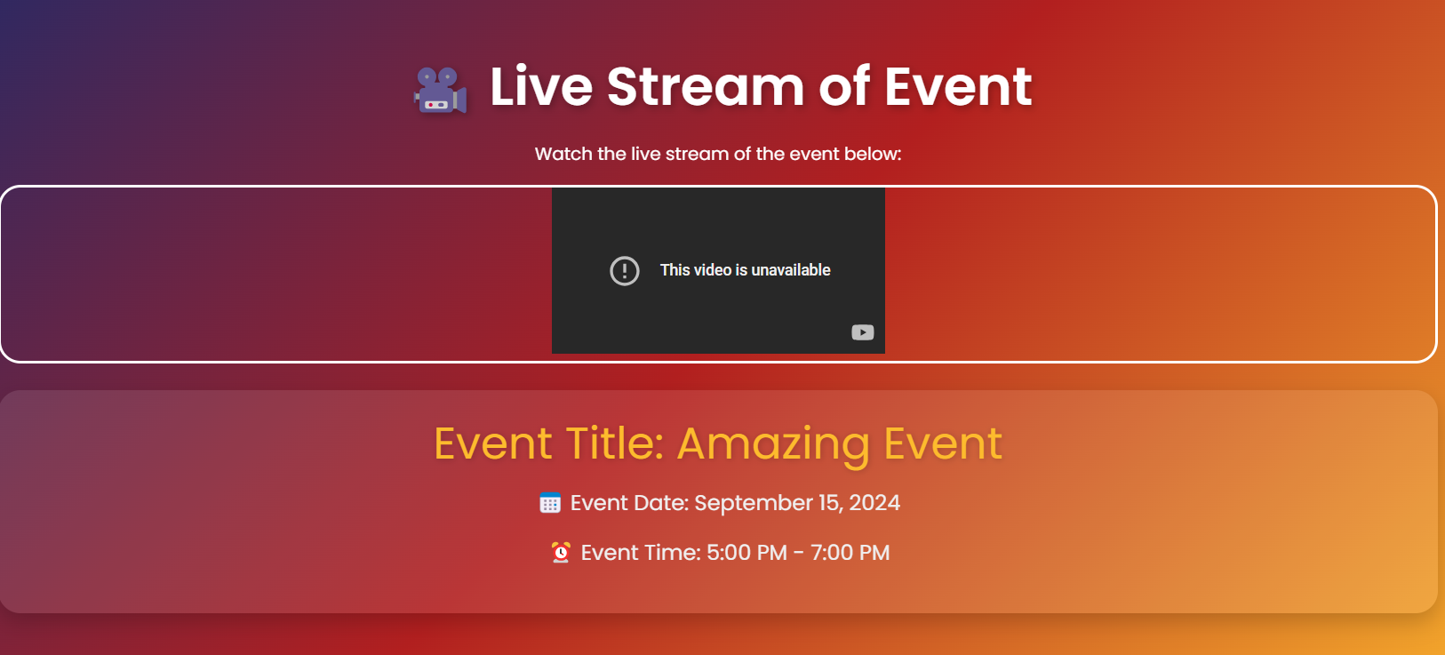

INNOVATION
The live stream, weather option on Eventopia sets it apart from other event booking websites by seamlessly integrating virtual event capabilities directly into the platform. This innovative feature allows users to not only plan and book physical events but also broadcast them live to a global audience, all within the same user-friendly interface

Slide 13
Conclusion
Eventopia is more than just an event booking website; it's a comprehensive platform designed to simplify and enhance the event planning experience. With its user-friendly interface, advanced features like live streaming, personalized recommendations, Eventopia stands out as an innovative solution in the event industry. Whether for personal celebrations, corporate events, or large-scale gatherings, Eventopia offers the flexibility, convenience, and tools necessary to create memorable events with ease. Join us in transforming the way events are booked and experienced—welcome to Eventopia, where every event is a special occasion.
.
.

Slide 14

Any Questions

Slide 15

References/Links Used
https://getbootstrap.com/
https://fontawesome.com/
https://fonts.google.com/
https://webrtc.org/

Slide 16



